Slide 1
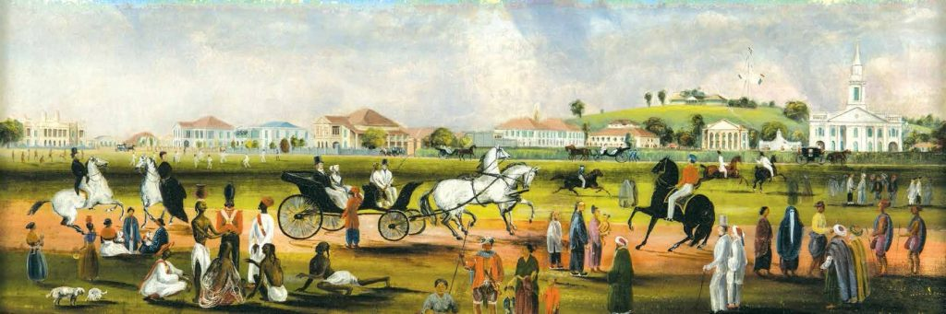
Lecture 2:
GES1009/SSA2203
AY2018-19
Dr. Brunero
The Padang, c.1851, by John Thomson Turnbull. NLB.

Slide 2
Lecture Overview:
Part One: Singapore’s pre-1819 history
Part Two: 1819 and Singapore’s early decades as an entrepot
(Next week: trading communities and commodities)

Slide 3
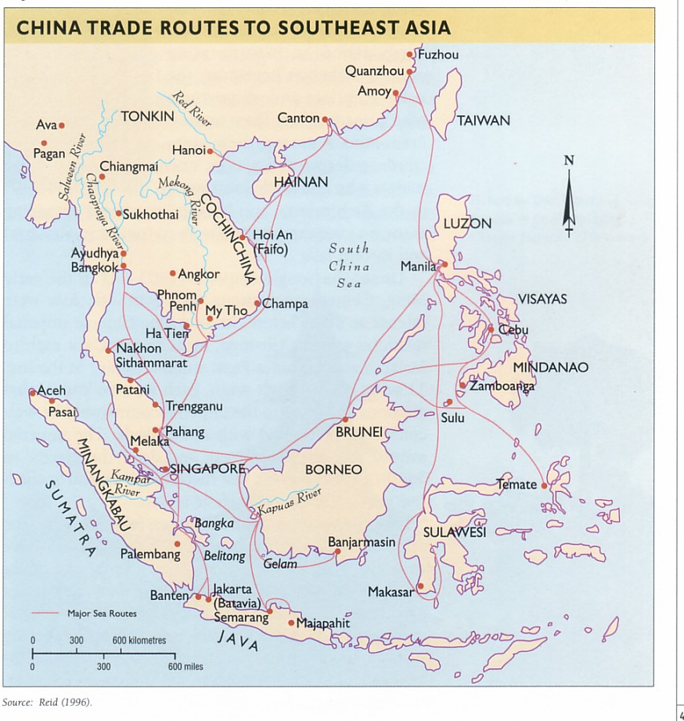
Traditionally, Southeast Asia was part of of a strong trading network connecting the Indian Ocean and also the South China Sea.
Monsoonal winds shaped trade patterns
Interactions with Arab, Indian traders and indigenous trading communities.
The ‘Junk’ trade was already operating in the 11th Century!
Spices, aromata, Food
Luxury items
Ceramics
Household wares
Textiles

Slide 4
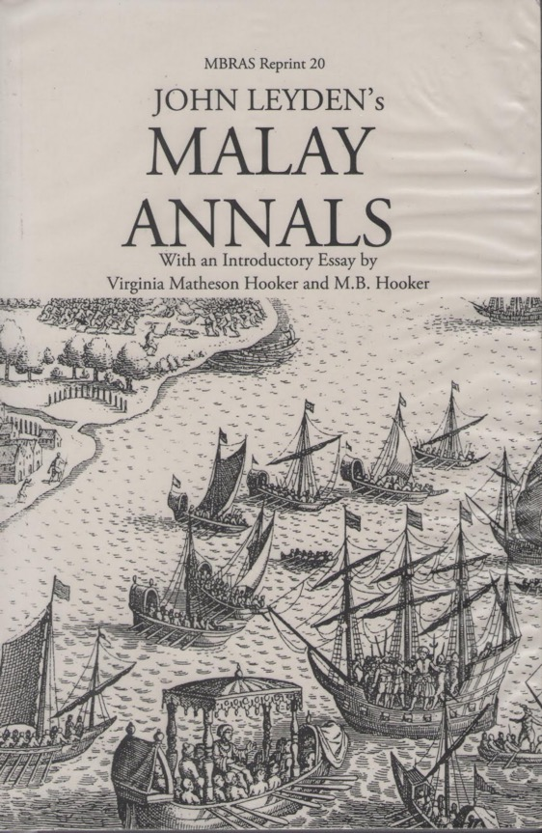
Temasek era
Mid 14th Century references to Temasek in Chinese texts and maps.
Most of what we know is derived from early Malay texts (Malay Annals), travellers accounts AND more recently, archaeological excavations.
What do these tell us?

Slide 5
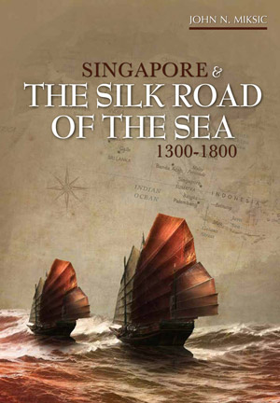
Temasek
Attracting travelers and traders.
A settlement near the riverbank, at the foot of (present day) Fort Canning.
Fortifications (earthen wall)
Trading communities on Temasek
Accounts by Wang Dayuan, Dao Yi Zhi Lue (Description of the Barbarians of the Isles) 1349.

Slide 6
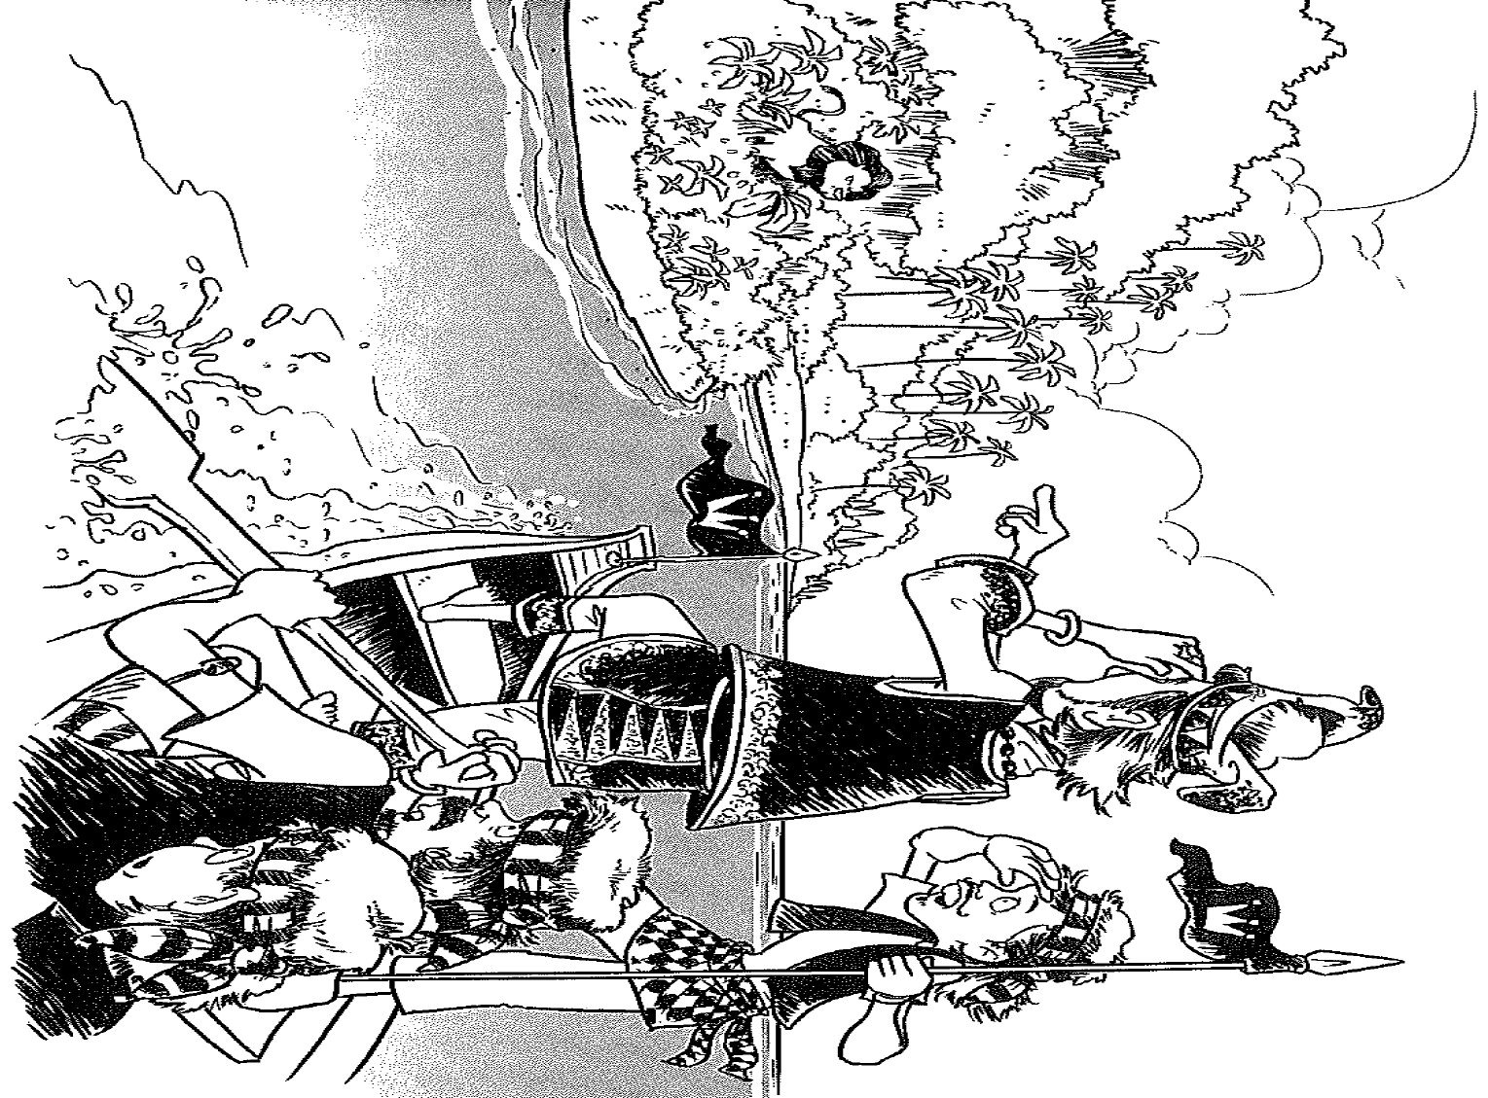

Slide 7
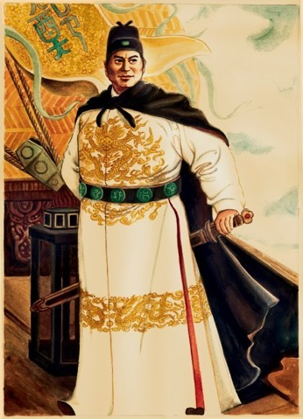
An Age of Commerce?
Ming voyages of the 1400s are regarded as a catalyst for increasing trade and interaction in maritime Asia.
Melaka, Brunei, Ayutthaya became key Southeast Asian ports and tributaries of the Ming Court.
Melaka emerged as the great trading emporium in Southeast Asia.
The Indian Ocean and Indian Ocean were increasingly interconnected.
Temasek? A supporting role to the Melaka Sultanate.

Slide 8
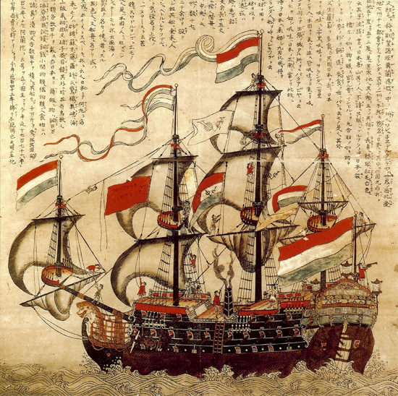
New currents? 1500-1800s
Portuguese and Spanish presence in Asia.
By the 1600s: Portuguese – Dutch struggle for predominance
British –Dutch rivalries in Southeast Asia via their East India Companies.
Trade, competition and violence…
Japanese depiction of a Dutch East India Company vessel c.1700

Slide 9
“Map of Asia featuring modern settlements and historic trading emporia of the 16th and 17th centuries.” (Provided by Peter Borschberg) from Farrell and Fairey, Empire in Asia: A New Global History, Vol.1.

Slide 10
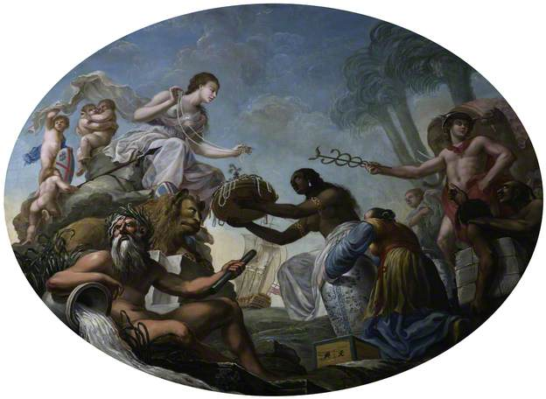
The East India Company
Founded in 1601
The EIC is regarded as a forerunner of the modern corporation.
By the 1750s it was a major political, territorial and commercial power in India.

Slide 11
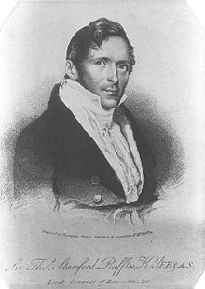
Part TWO: 1819
Founding of an EIC base in Singapore.
Raffles, William Farquhar and John Crawford as key figures in early Singapore’s development.
By 1824 Singapore was secured as a British (EIC) territory.
Singapore—Penang—Melaka: The Straits Settlements.

Slide 12
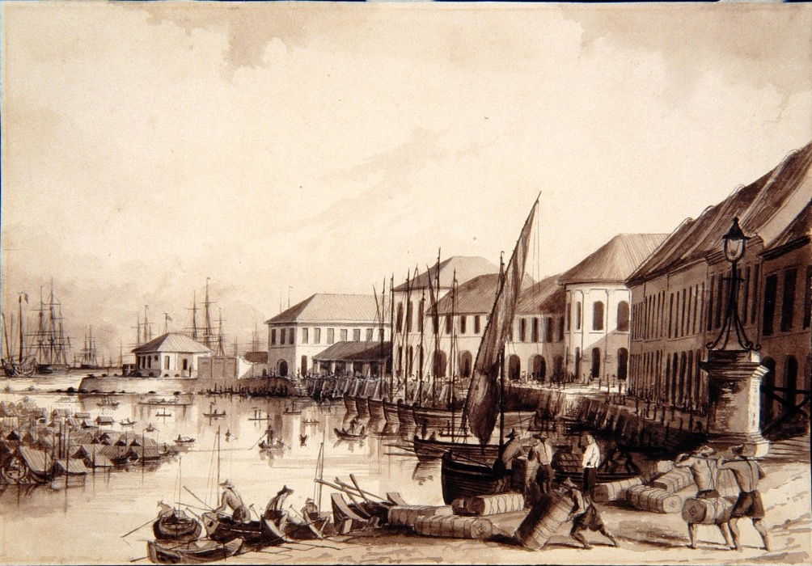
Singapore River
The focal point for traders and the new EIC settlement.
Two trading seasons: the junk season and the Bugis season.
The number of residents and ships (and volume of trade) grew rapidly.
The EIC needed to respond to traders demands for better facilities (docks/infrastructure) to support trade.

Slide 13
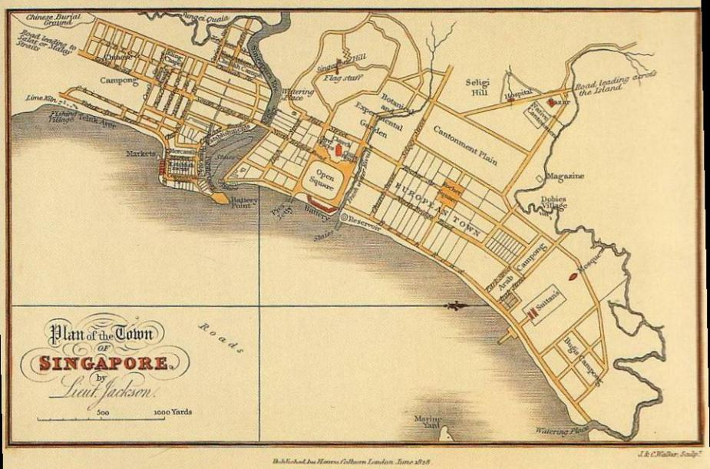
Raffles Town Plan, 1822.

Slide 14
An observer in 1833:
“Ships from all parts of the world are constantly arriving…and the flags of Great Britain, Holland, France and America may often be seen intermingled with the streamers of the Chinese junks, and the fanciful colours of the native perahus…”
Chinese, Malays, Bugis, Javanese, natives of Bengal and Madras, Parsees, and Arabs could all be seen at the port.
George Windsor Earl, 1833
Qyoted in Frost & Balasingham-Chow, Singapore: A Biography.

Slide 15
“The free trade policy became the root of Singapore’s prosperity.”
Historian Edwin Lee
Three Branches of Trade:
Transshipment trade
Imports for local consumption – exports of local products
Entrepôt trade

Slide 16
Entrepôt Trade
A specialized port of call acting as a collection centre, where cargoes are held for loading or distribution
Free port status
Heavily reliant on maritime networks and good business connections.
Singapore grew as an international trading centre.

Slide 17
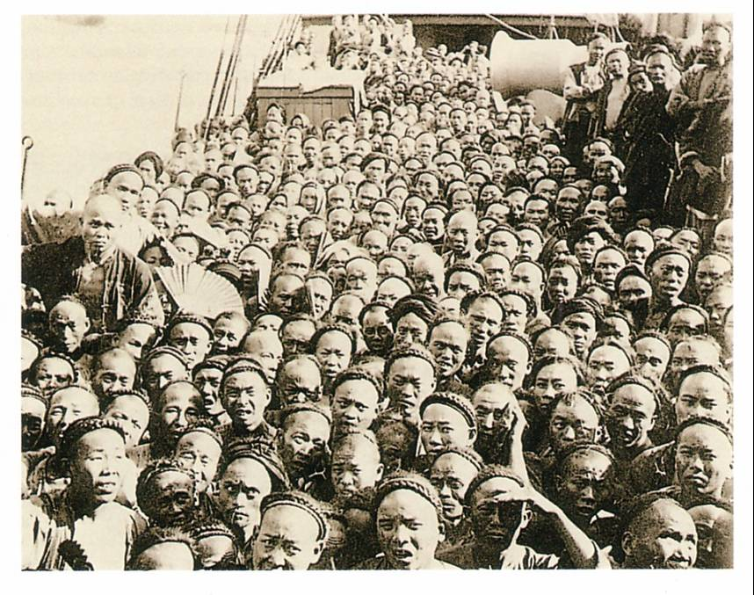
Factors contributing to the growth of Singapore :
Freedom of trade
Geographical location
A good harbour
Trade networks, cheap labour, global demand for certain commodities.
Trading communities: ‘Straits Chinese’, Indians, Arabs, Europeans

Slide 18
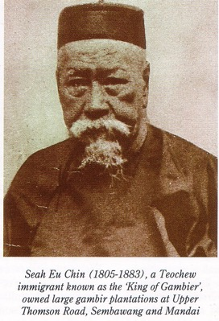
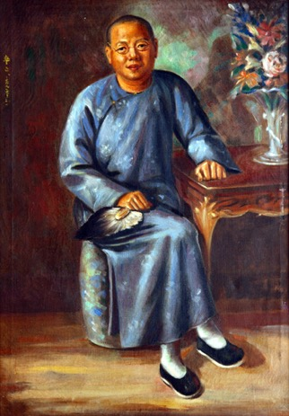
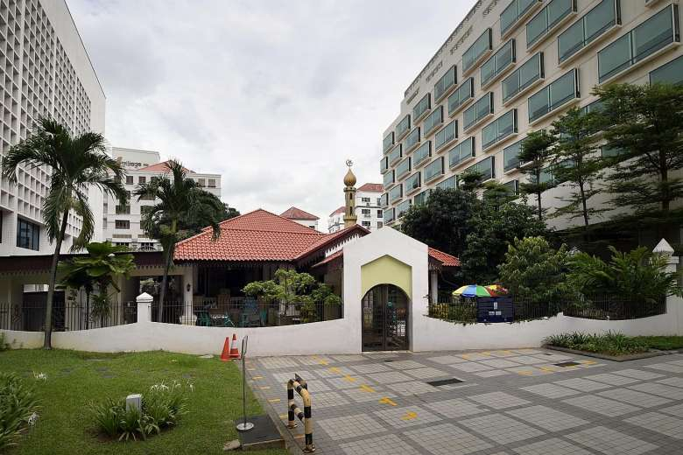
Singapore : early migrants
Tan Tock Seng
Syed Omar Aljunied
Seah Eu Chin
Each emerged as important community leaders.
Masjid Omar Kampong, built by Syed Omar Aljunied.

Slide 19
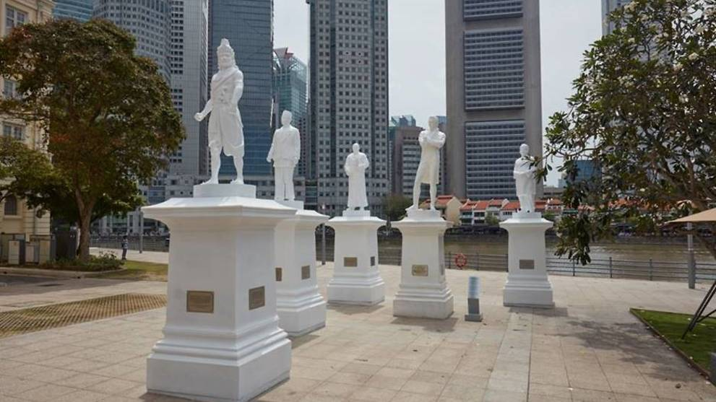
Sang Nila Utama, Tan Tock Seng, Munshi Abdullah and Naraina Pillai.
https://www.straitstimes.com/singapore/four-more-statues-join-sir-stamford-raffles-statue-along-singapore-river

Slide 20
Building a new settlement

Slide 21
Summing up:
The history of this island as Temasek and Singapura demonstrates that over the centuries there were maritime and trade links to the region and beyond.
The early decades of following 1819 saw Singapore develop (once again) as a thriving maritime centre: the Singapore River was the focus of trade.
The majority of early migrants were Chinese (brought in as labourers) but many other trading communities also had a presence in Singapore.

Slide 22
Further readings:
Mark R. Frost and Yu-Mei Balasinghamchow, Singapore: A Biography.
C. Trocki on the gambier and pepper trade.
Wong Lin Keng on Singapore’s early trade statistics.
https://www.straitstimes.com/singapore/masjid-omar-kampong-melaka-singapores-oldest-mosque-and-first-place-of-worship

